Slide 1
INTENSIVE DATA ANALYSIS II

Slide 2
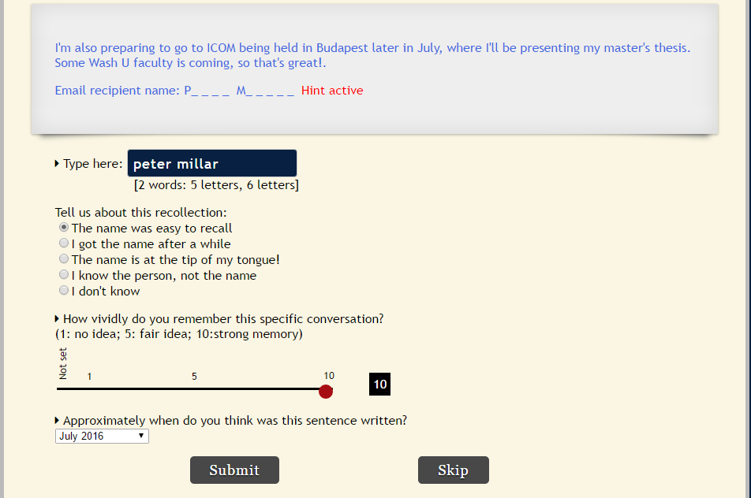

Slide 3
Key Variables
Independent Variables:
Days/Month: number of days since last email conversation with recipient (0-365/0-11)
Messages: total number of emails sent to the recipient over the year
Vividness: Scale of 1(no memory) – 10 (strong memory)
Dependent Variables
Name accuracy: (0,1)
Time Judgments: Month of sent email (0-11)
Temporal Distance: Distance between actual month and participant’s estimate of the month (0-11)

Slide 4
Correlation Matrix
 | Accuracy | Messages | Vividness | Month | Temporal Distance | Month_0
Accuracy | 1 | 0.13 | 0.58 | -0.23 | -0.35 | -0.23
Messages | 0.13 | 1 | 0.1 | -0.24 | -0.07 | -0.24
Vividness | 0.58 | 0.1 | 1 | -0.32 | -0.42 | -0.32
Month | -0.23 | -0.24 | -0.32 | 1 | 0.31 | 1
TimeJudgmentDistance | -0.35 | -0.07 | -0.42 | 0.31 | 1 | 0.31
Month_0 | -0.23 | -0.24 | -0.32 | 1 | 0.31 | 1

